Slide 1
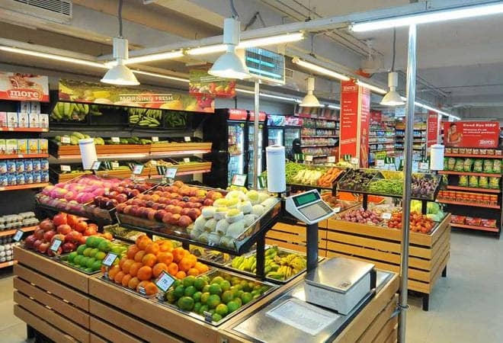
Super Mart Billing System

Slide 2
Contents
Existence
Proposal
Software Requirements
Use case diagram
Table diagram
Conclusion

Slide 3

Existence

Slide 4
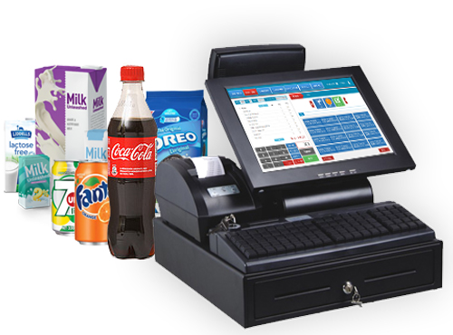
Proposal

Slide 5
Software Requirements
Front End:
Java eclipse
Java swings for User Interface
Back End:
oracle
Connection:
JDBC

Slide 6
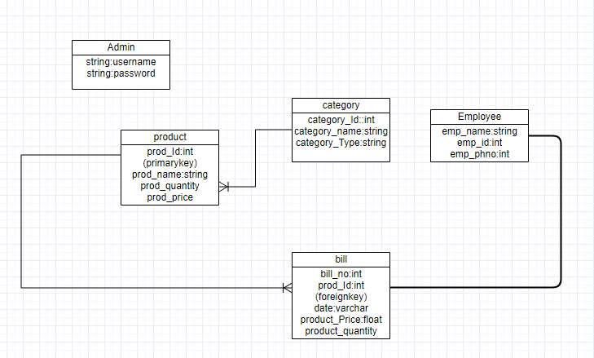
ER-Table Diagram

Slide 7
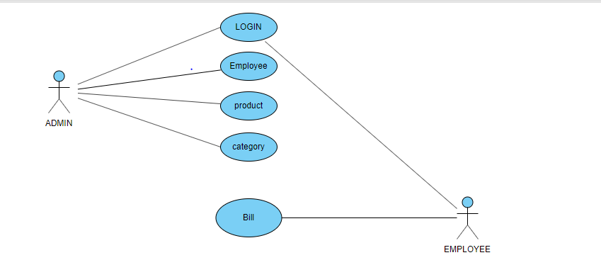
Use Case Diagram

Slide 8


